Slide 1
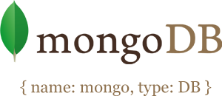

Slide 2
Agenda:
Difference between NoSQL and SQL DB.
When and when not to use NoSQL.
Pros and cons of NoSQL DB.
Introduction to mongoDB.
Installation.
Collections and documents.
Data modelling
Embedded document and Document Referencing
Basic query -> Creating DB, Collection, Documents -> get/update/delete document
Notes:
relational (SQL) or non-relational (NoSQL) data structure. While both the databases are viable options still there are certain key differences between the two that users must keep in mind when making a decision.
The Main Differences:
Type – SQL databases are primarily called as Relational Databases (RDBMS); whereas NoSQL database are primarily called as non-relational or distributed database.
Language – SQL databases defines and manipulates data based structured query language (SQL). Seeing from a side this language is extremely powerful. SQL is one of the most versatile and widely-used options available which makes it a safe choice especially for great complex queries. But from other side it can be restrictive. SQL requires you to use predefined schemas to determine the structure of your data before you work with it. Also all of your data must follow the same structure. This can require significant up-front preparation which means that a change in the structure would be both difficult and disruptive to your whole system. A NoSQL database has dynamic schema for unstructured data. Data is stored in many ways which means it can be document-oriented, column-oriented, graph-based or organized as a KeyValue store. This flexibility means that documents can be created without having defined structure first. Also each document can have its own unique structure. The syntax varies from database to database, and you can add fields as you go.
The Scalability – In almost all situations SQL databases are vertically scalable. This means that you can increase the load on a single server by increasing things like RAM, CPU or SSD. But on the other hand NoSQL databases are horizontally scalable. This means that you handle more traffic by sharding, or adding more servers in your NoSQL database. It is similar to adding more floors to the same building versus adding more buildings to the neighborhood. Thus NoSQL can ultimately become larger and more powerful, making these databases the preferred choice for large or ever-changing data sets.
The Structure – SQL databases are table-based on the other hand NoSQL databases are either key-value pairs, document-based, graph databases or wide-column stores. This makes relational SQL databases a better option for applications that require multi-row transactions such as an accounting system or for legacy systems that were built for a relational structure.
Property followed – SQL databases follow ACID properties (Atomicity, Consistency, Isolation and Durability) whereas the NoSQL database follows the Brewers CAP theorem (Consistency, Availability and Partition tolerance).
Support – Great support is available for all SQL database from their vendors. Also a lot of independent consultations are there who can help you with SQL database for a very large scale deployments but for some NoSQL database you still have to rely on community support and only limited outside experts are available for setting up and deploying your large scale NoSQL deployments. Some examples of SQL databases include PostgreSQL, MySQL, Oracle and Microsoft SQL Server. NoSQL database examples include Redis, RavenDB Cassandra, MongoDB, BigTable, HBase, Neo4j and CouchDB

Slide 3
Introduction to mongoDB
MongoDB is a document database that provides high performance, high availability, and easy scalability.
Document Database
Documents (objects) map nicely to programming language data types.
Embedded documents and arrays reduce need for joins.

Slide 4
High Performance
Embedding makes reads and writes fast.
Indexes can include keys from embedded documents and arrays.
High Availability
Replicated servers with automatic master failover.
Easy Scalability
Automatic sharding distributes collection data across machines.
Eventually-consistent reads can be distributed over replicated
servers.

Slide 5
Latest Stable version of mongodb
4.0

Slide 6
To get started, there are six simple concepts we need
to understand
MongoDB has the same concept of a database with which you are likely already familiar (or a schema for you Oracle folks). Within a MongoDB instance you can have zero or more databases, each acting as high-level containers for everything else.
A database can have zero or more collections . A collection shares enough in common with a traditional table that you can safely think of the two as the same thing.
Collections are made up of zero or more documents .Again, a document can safely be thought of as a row .

Slide 7
A document is made up of one or more fields , which you can probably guess are a lot like columns .
Indexes in MongoDB function much like their RDBMS counterparts.
When we ask MongoDB for data, it returns a cursor, which we can do things to, such as counting or skipping ahead, without actually pulling down data.

Slide 8

Counterparts from SQL world
Table become Collection
Row become Document
Column become Field
The core difference comes from the fact that relational databases define columns at the
table level whereas a document-oriented database defines its fields at the document level.
Notes:
relational (SQL) or non-relational (NoSQL) data structure. While both the databases are viable options still there are certain key differences between the two that users must keep in mind when making a decision.
The Main Differences:
Type – SQL databases are primarily called as Relational Databases (RDBMS); whereas NoSQL database are primarily called as non-relational or distributed database.
Language – SQL databases defines and manipulates data based structured query language (SQL). Seeing from a side this language is extremely powerful. SQL is one of the most versatile and widely-used options available which makes it a safe choice especially for great complex queries. But from other side it can be restrictive. SQL requires you to use predefined schemas to determine the structure of your data before you work with it. Also all of your data must follow the same structure. This can require significant up-front preparation which means that a change in the structure would be both difficult and disruptive to your whole system. A NoSQL database has dynamic schema for unstructured data. Data is stored in many ways which means it can be document-oriented, column-oriented, graph-based or organized as a KeyValue store. This flexibility means that documents can be created without having defined structure first. Also each document can have its own unique structure. The syntax varies from database to database, and you can add fields as you go.
The Scalability – In almost all situations SQL databases are vertically scalable. This means that you can increase the load on a single server by increasing things like RAM, CPU or SSD. But on the other hand NoSQL databases are horizontally scalable. This means that you handle more traffic by sharding, or adding more servers in your NoSQL database. It is similar to adding more floors to the same building versus adding more buildings to the neighborhood. Thus NoSQL can ultimately become larger and more powerful, making these databases the preferred choice for large or ever-changing data sets.
The Structure – SQL databases are table-based on the other hand NoSQL databases are either key-value pairs, document-based, graph databases or wide-column stores. This makes relational SQL databases a better option for applications that require multi-row transactions such as an accounting system or for legacy systems that were built for a relational structure.
Property followed – SQL databases follow ACID properties (Atomicity, Consistency, Isolation and Durability) whereas the NoSQL database follows the Brewers CAP theorem (Consistency, Availability and Partition tolerance).
Support – Great support is available for all SQL database from their vendors. Also a lot of independent consultations are there who can help you with SQL database for a very large scale deployments but for some NoSQL database you still have to rely on community support and only limited outside experts are available for setting up and deploying your large scale NoSQL deployments. Some examples of SQL databases include PostgreSQL, MySQL, Oracle and Microsoft SQL Server. NoSQL database examples include Redis, RavenDB Cassandra, MongoDB, BigTable, HBase, Neo4j and CouchDB

Slide 9
Collection
A collection is the equivalent of an RDBMS table.
Collections do not enforce a schema and is a grouping of MongoDB documents.
For example “student” collection containing several documents for each student.

Slide 10
Documents
MongoDB documents are composed of field-and-value pairs and have the following structure:
{
field1: value1,
field2: value2,
field3: value3,
...
fieldN: valueN
}
NOTE: Field names are strings. Field names cannot contain null characters, dots (.) or dollar signs ($).Each document within a collection can have its own unique set of fields .

Slide 11
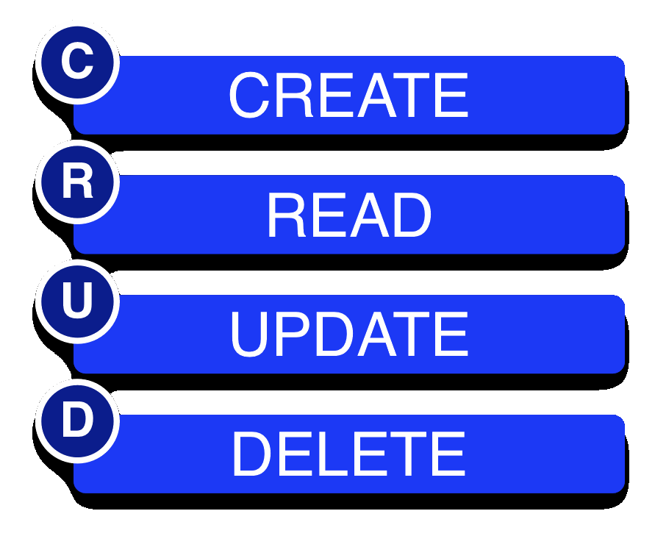
CRUD

Slide 12
Create Collection
db.createCollection(name, {<options>})
For example:
db.createCollection(“demo”).

Slide 13
Insert
db.collection.insert(document)
For example:
db.unicorns.insert({name: ’Aurora’, gender: ’f’, weight: 450})
NOTE:The insert() method has the following behaviors:
If the collection does not exist, then the insert() method will
create the collection.
If the document does not specify an _id field, then MongoDB will add
the _id field and assign a unique ObjectId for the document before inserting.
Most drivers create an ObjectId and insert the _id field, but the mongod will
create and populate the _id if the driver or application does not.
If the document specifies a new field, then the insert() method inserts the
document with the new field. This requires no changes to the data model for the
collection or the existing documents.
Notes:
ObjectIds are small, likely unique, fast to generate, and ordered. ObjectId values consist of 12 bytes, where the first four bytes are a timestamp that reflect the ObjectId’s creation. Specifically:
"a 4-byte value representing the seconds since the Unix epoch,
a 3-byte machine identifier,
a 2-byte process id, and
a 3-byte counter, starting with a random value.

Slide 15
Read
Find() command is a very useful command for retrieving data on the basis of some condition or selection criteria.
Syntax:
db.collection.find(<criteria>, <projection>)
where criteria and projection both are optional.
It returns a cursor to the documents that match the query
criteria.

Slide 16
The projection parameter takes a document of the following form:
{ field1: <boolean>, field2: <boolean> ... }
The <boolean> value can be any of the following:-
1 or true to include the field. The find() method always
includes the _id field even if the field is not explicitly stated to return in the
projection parameter.
0 or false to exclude the field.
NOTE: A projection cannot contain both include and exclude specifications,
except for the exclusion of the _id field.
In projections that explicitly include fields, the _id field is the only field that you can explicitly exclude.

Slide 17
Query for Equality
db.unicorns.find({gender: ’m’})

Slide 18
Query for Ranges
$gt (greater than)
$gte (greater than equal to)
$lt (less than)
$lte(less than equal to)
$ne (not equal to)
For example:
db.unicorns.find({gender: {$ne: ’f’}, weight: {$gte: 701}})

Slide 19
Query Using Operators
$in
$or
$and
$exists

Slide 20
Update
Modifies an existing document or documents in a collection.
Syntax: db.collection.update(query, update, options)
Options:
1. upsert: If set to true, creates a new document when no document matches the query criteria.
The default value is false, which does not insert a new document when no match is found.
2. multi: If set to true updates multiple documents otherwise only first one is updated by default.

Slide 21
$set operator
$set modifier is used to replace the value of a field to the specified value.
If the field does not exist, the $set operator will add the field with the specified value.
For example:
db.unicorns.update({name: ’Roooooodles’}, {$set: {weight: 590}})

Slide 22
Some other useful operators
$inc
$push
$addToSet

Slide 23
Ordering
db.unicorns.find().sort({weight: -1})
NOTE: We specify the fields we want to sort on,
using 1 for ascending and -1 for descending.

Slide 24
Pagination
Paging results can be accomplished via the limit and skip cursor methods.
For example:
db.unicorns.find().sort({weight: -1}).limit(2).skip(1)

Slide 25
Count
db.unicorns.count({vampires: {$gt: 50}})
Or
db.unicorns.find({vampires: {$gt: 50}}).count()

Slide 26
Remove
db.collection.remove(query, justOne)
Removes documents from a collection.
db.collection.drop()
Called on a collection to drop it from the database.

Slide 27
Arrays and Embedded Documents
MongoDb turns out to be incredibly handy when dealing with many-to-one
or many-to-many relationships.
Example:
db.employees.insert({_id: ObjectId(”4d85c7039ab0fd70a117d733”),
name: ’Siona’,
manager: [ObjectId (”4d85c7039ab0fd70a117d730”),
ObjectId(”4d85c7039ab0fd70a117d732”)]
})
db.employees.insert({_id: ObjectId(”4d85c7039ab0fd70a117d734”),
name: ’Ghanima’,
family: {mother:’Chani’,
father: ’Paul’, brother: ObjectId(”4d85c7039ab0fd70a117d730”)}
})

Slide 28
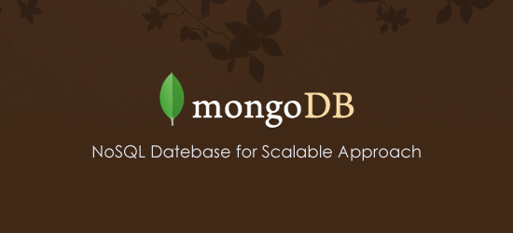
Thank You!!

Slide 29
Exercise
Create a Database named 'MYWall'
Create two collections named 'user and ''post'
Insert some post related information like post_id, title, description , posted_by, comments, created_at etc…
Comments should be an array of objects which has comment_id, message, timestamp
Write query to add a new comment for a post
Write a query to update description of a post
Write query to update comment message
Write query to remove a comment

